Slide 1


SALES LEAD MANAGEMENT SYSTEM

Slide 2

“
Get closer than ever to your customers. So close that you tell them what they need well before they realize it themselves.
– Steve Jobs
Sales Lead Management System HELPS Sales Person SOLVES their problem to collect, record, follow up and tracking the sales opportunity BY providing simple but comprehensive system THAT IS BETTER THAN manual recording and tracking BECAUSE it improves time-to-sales and eases to search potential customers and sales leads and reduces the loss of sales opportunities.
Istofani Api Diany – fitinline.com

Slide 3

WHY THIS
IMPORTANT
Data Management
Data Tracking
Scatter data, un-integrated with other system, from many sources, with different formats
Not easy to track history data, data is not related one to another
Data Analyzing
Customer Loyalty
No tool to analyze data, data is not well structured, facts/decision is difficult to make from the data
Digging the internal data is the easiest way to generate the lead, customer loyalty is key to company to sustain
Istofani Api Diany – fitinline.com

Slide 4
IMPLEMENTATION
April 2019
Design System
June 2019
Coding & Testing
August 2019
Integration
Design the layout / form (graphical user interface), user experience, and interaction between modules and analyse the important output
Preparing staging environment, involve user to test, revising flow / features if needed, fix the bugs
Build integration with other system, automate manual system
01
02
03
04
05
06
Requirement Analysis
Coding & Testing
Deployment
Collect requirement from customer, business owner, sales person dan technical perspective and preparing resources
Preparing development environment, start coding, and testing modules functionalities and all features.
Preparing production environment, deploy tested code and parallel run with manual system
May 2019
July 2019
September 2019
Istofani Api Diany – fitinline.com

Slide 5
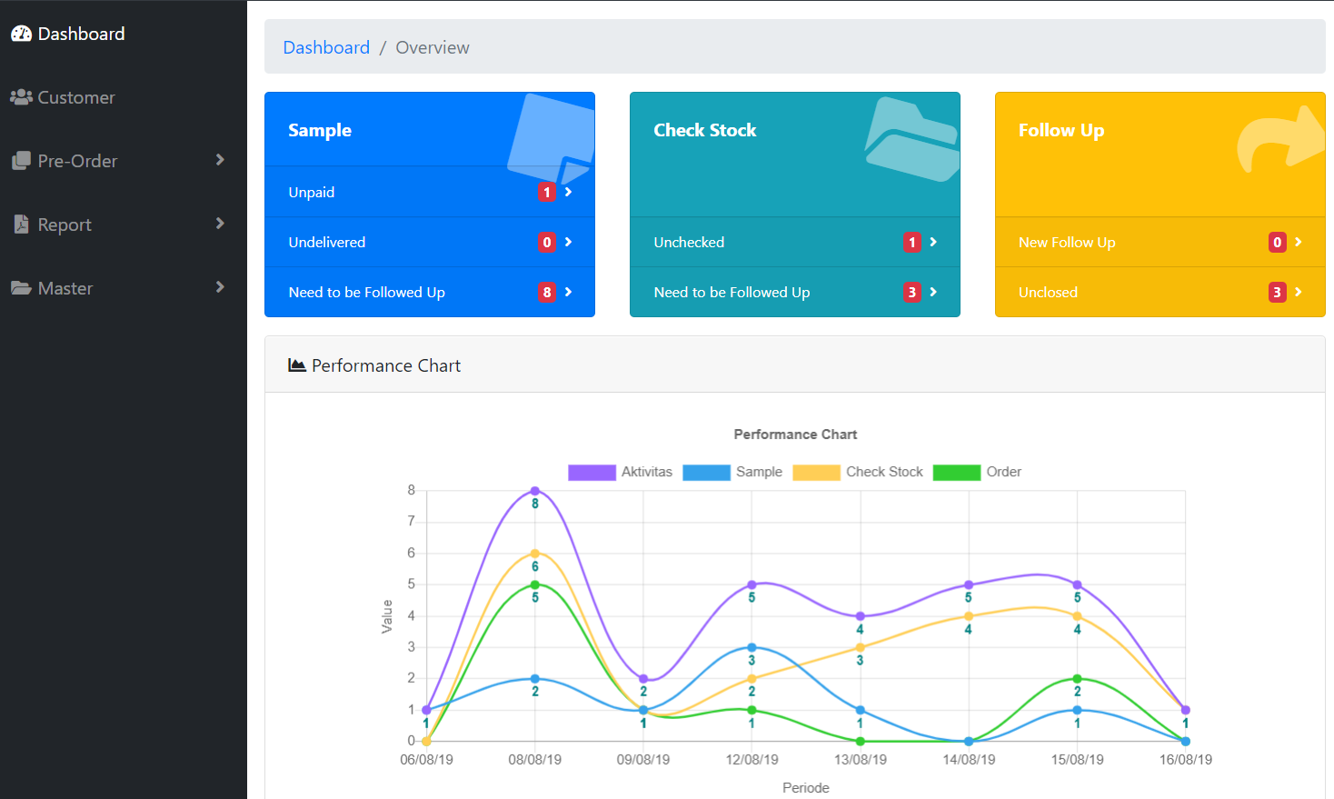
Istofani Api Diany – fitinline.com

Slide 6
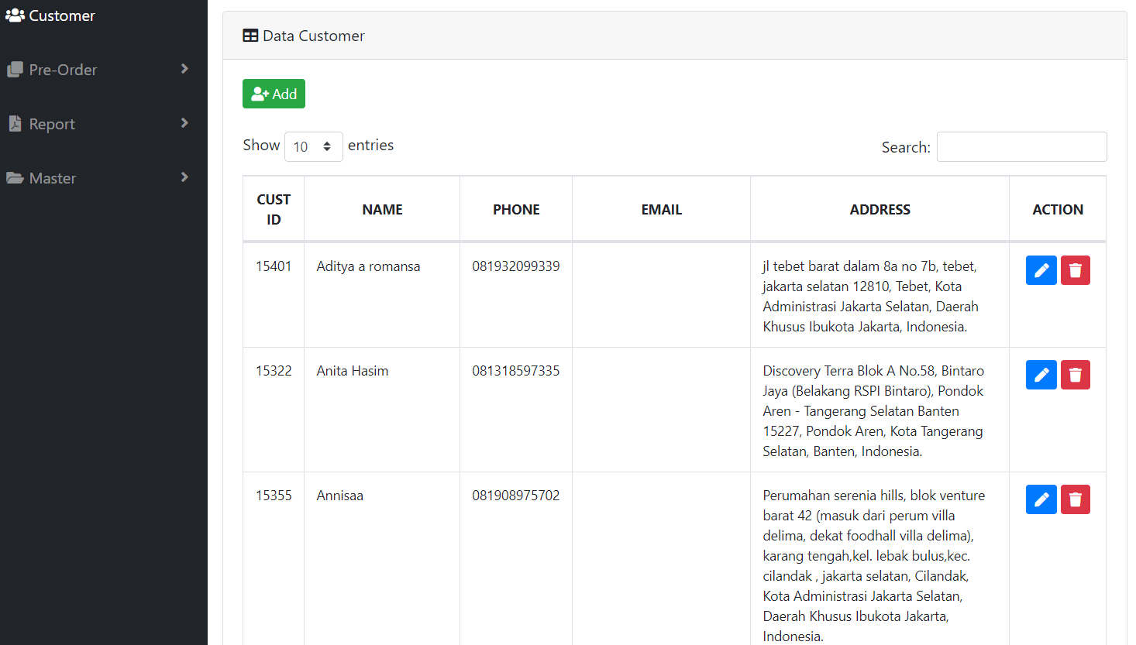
Istofani Api Diany – fitinline.com

Slide 7
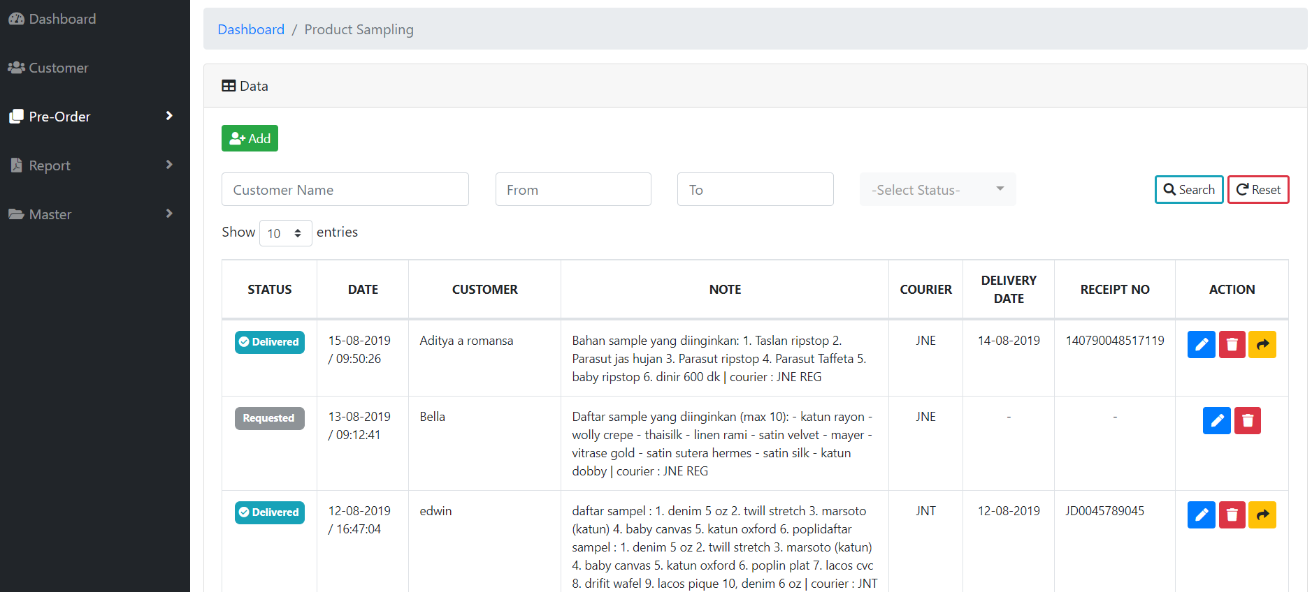
Istofani Api Diany – fitinline.com

Slide 8
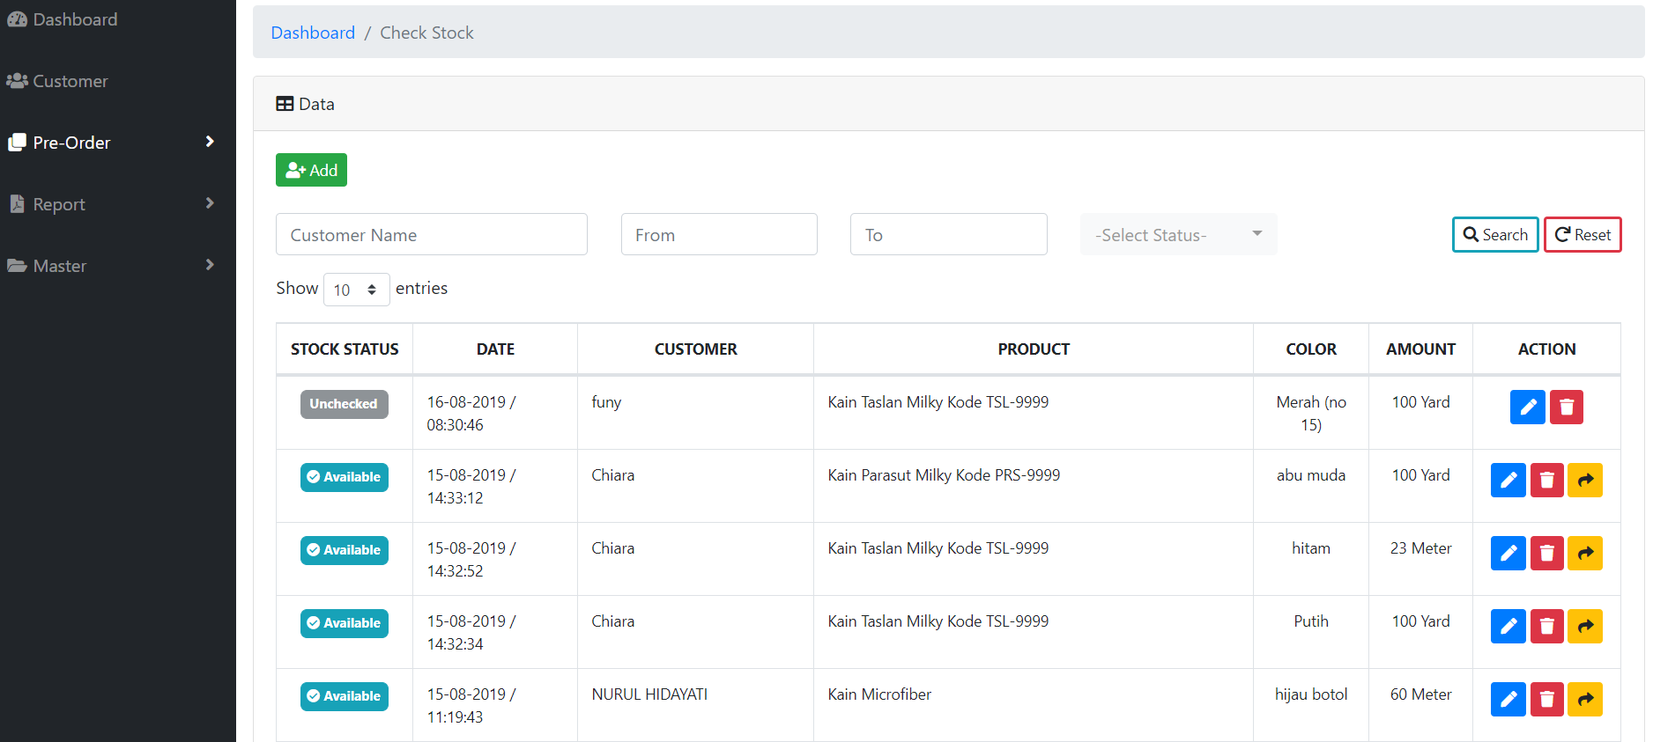
Istofani Api Diany – fitinline.com

Slide 9
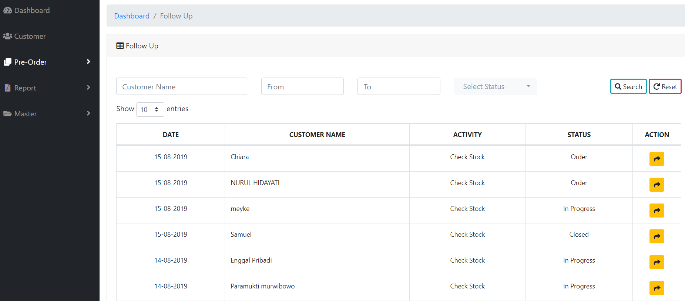
Istofani Api Diany – fitinline.com

Slide 10
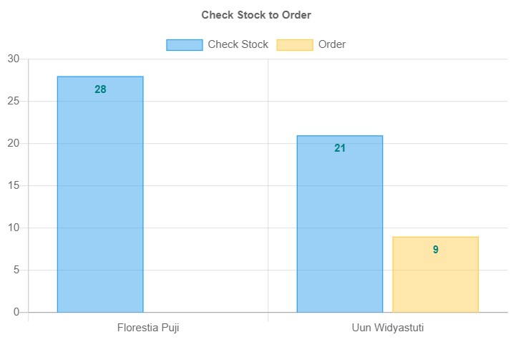
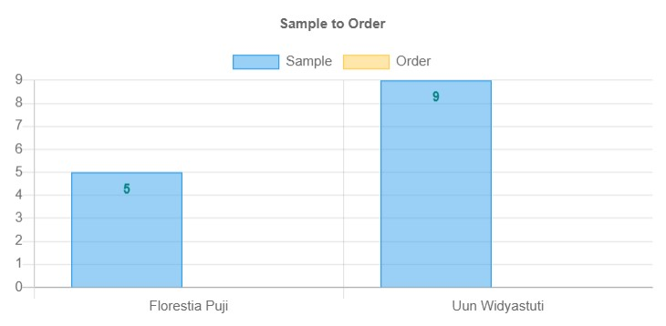
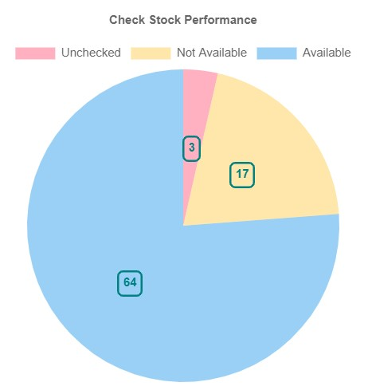
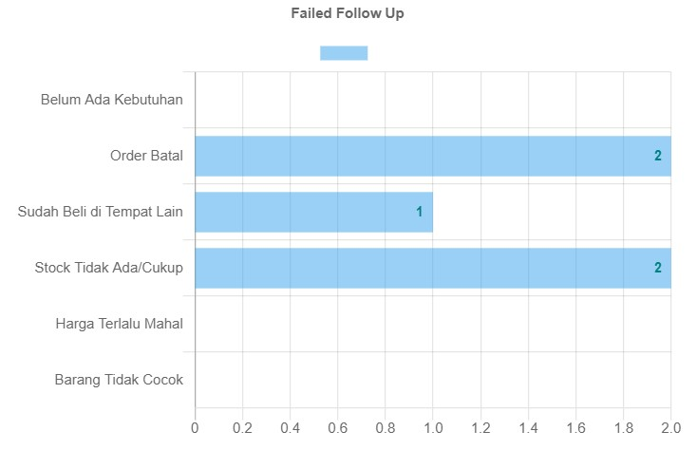
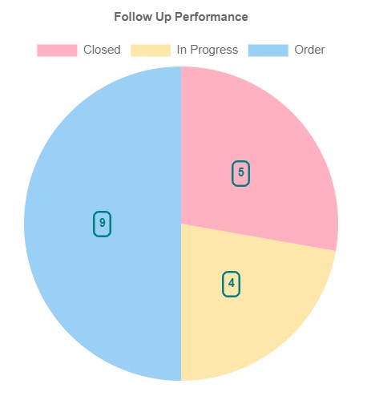
REPORTS
Istofani Api Diany – fitinline.com

Slide 11
OUTCOMES
& RECOMMENDATIONS
Outcomes
Recommendations
OPPORTUNITY FINDING
70%
Communication
86%
Improve communication with suppliers, vendors, customers and between sales persons and sales support
PRESALES PERFORMANCE
90%
REALTIME REPORTING
100%
Integration
Integrate with other modules / channels, improve interoperability
Generalization
Make a general specification for general use of sales lead management
Istofani Api Diany – fitinline.com

Slide 12
LESSONS
LEARNED
Profit vs Growth
Technology
Government Support
In Australia, Startup is about making profit. In Indonesia, startup is about raising fund
Startups in Australia use extensive technology, while di Indonesia, startups focus on Consumer need.
Government support is important to build startup ecosystem, maintain professional service
Istofani Api Diany – fitinline.com

Slide 13
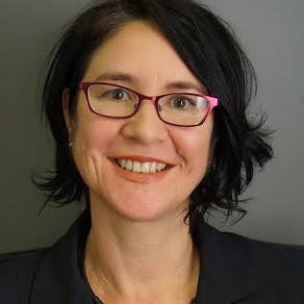


AAI
CONTACTS
Alison Jose
Andrew Lai
Orchida S Danudjaja
Sustainable Textile
Financial Modelling
Consul - Economics at Consulate General of the Republic of Indonesia in Melbourne
Istofani Api Diany – fitinline.com

Slide 14

THANK YOU
Head Office
Phone
Website
Jl. Godean Km 4.5 Yogyakarta
+62 274 530 5094
https://fitinline.com

